Slide 1
THE CYBER WORLD
A Awarness seminar on the topic Cyber Security
GUIDE NAME : MRS. SHABNA
(ASSISTANT PROFESSOR ,CSE DEPT, MGM COLLEGE OF ENGINEERING AND PHARMACEUTICAL SCIENCE VALANCHERY)
PRESENTED BY: AJAY DAS K
(CCV19CS002)

Slide 2
INTRODUCTION
01
04
MAIN OBJECTIVES
OBJECTIVES
02
05
THE FUTURE
LITERATURE SURVEY
03
06
CONCLUTION AND REFERENCE
CONTENTS OF THESEMINAR
Introduction about myself
The main proposed system
The aim of the seminar
The futere projects
The papers surveyed
The help that taken for the project

Slide 3

"I’m a Cyber Security Tester Developer , Programmer , DJ ,Graphic Designer , Web Developer and B-tech Student Follow me on : https://ajustechhub.000webhostapp.com/
1.Who am I ?

Slide 4
2.OBJECTIVES
THE AWARNESS
SOLUTION
To prepare students with the technical knowledge and skills needed to protect and defend computer systems and networks.
To develop plan that can plan, implement, and monitor cyber security mechanisms to help ensure the protection of information technology assets.

Slide 5
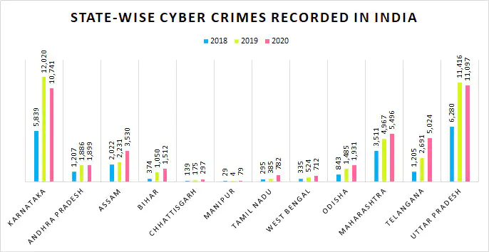
Cyber Crimes Analysis

Slide 6
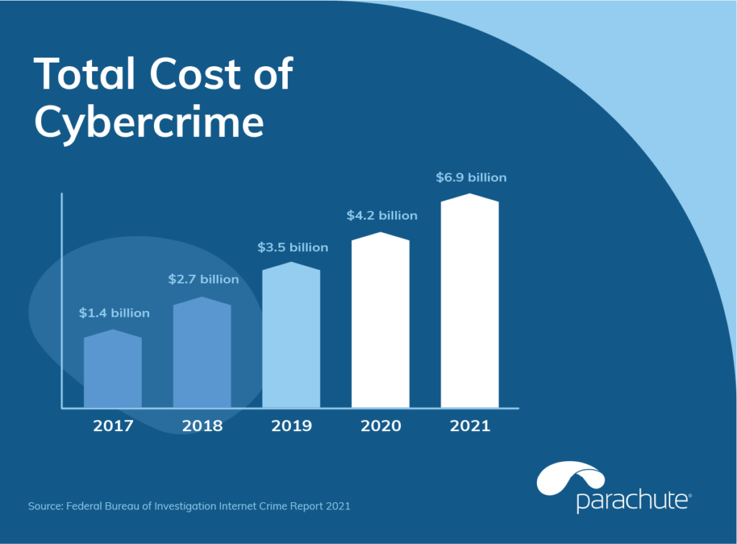
Cyber Crimes Analysis

Slide 7
3.LITERATURE SURVEY
S1.NO | PAPER NAME | DETAILS | METHODOLOGY | ADVANTAGES | DISADVANTAGE
1 | Cyber Attack-COVID Stress (Cyber Higiene “Wash Your Cyber Data Regularly”) | International Journal of Engineering Research & Technology (IJERT) ISSN: 2278-0181 IJERTV10IS060103 Vol. 10 Issue 06, June-2021 | Intrusion detection Situational awareness Cyber–physical | Cyber security Awareness about cyber thraets | Lack of importance amoung people
2 | A comprehensive review study of cyber-attacks and cyber security; Emerging trends and recent developments | Energy Reports 7 (2021) 8176–8186 ScienceDirect | Information technology Cyber-attacks Cyber security Emerging trends Key management | Cyber space threats Info about Cyber-security Cyber-security policy | Individuals and companies will not be immune to the harms of these threats.
3 | Ethical Hacking Techniques with Penetration Testing | International Journal of Engineering Research & Technology (IJERT) ISSN: 2278-0181 - 2019 | Ethical Hacking, Hackers, Hacking Phases. | Basic info about hacking and its phases | Used older tech
4 | Ethical Hacking | International Journal of Engineering Research & Technology (IJERT) ISSN: 2278-0181 NSDMCC - 2015 | Ethical Hacking, Hackers, Hacking Phases | Type of ethical hackers | Therotical approch

Slide 8
4.PROPOSED SYSTEM
Cyber space
Cyberspace refers to the virtual computer world, and more specifically, an electronic medium that is used to facilitate online communication.
Cyberspace allows users to share
information,
interact,
swap ideas,
play games,
engage in discussions or social forums,
conduct business and create intuitive media,
among many other activities.

Slide 9
What is cyber security ?
The cyber security
*Cybersecurity is the practice of
protecting systems,
Networks
programs
from digital attacks.
*These cyberattacks are usually aimed at
Accessing
Changing
destroying sensitive information
extorting money from users
interrupting normal business processes.

Slide 10
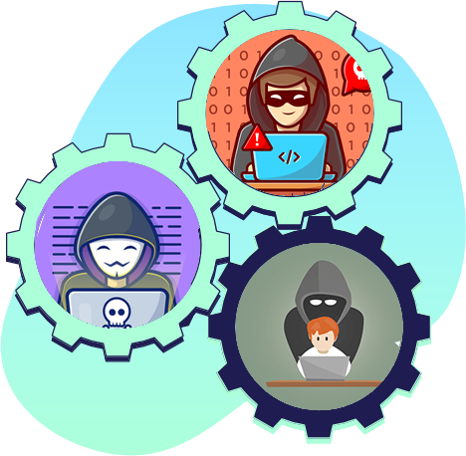
Hackers
White Hat
Black Hat
Gray Hat
Ethical Hackers or a Penetration Tester.
White hat hackers are the good guys of the hacker world.
Unethical Hacker or a Security Cracker.
These people hack the system illegally to steal money or to achieve their own illegal goals
Gray hat Hackers are Hybrid between Black hat Hackers and White hat hackers.
They can hack any system even if they don't have permission to test the security of the system but they will never steal money or damage the system.

Slide 11
Cyber security threats
Malware
Password Attacks
DoS
Man in middle
Phishing
Sql injection
Malware is malicious software such as spyware, ransomware, viruses and worms.
strategy cyber attackers use that relies heavily on human interaction and often involves tricking people into breaking standard security practices.
cyber attack that floods a computer or network so it can’t respond to requests.
(MITM) attack occurs when hackers insert themselves into a two-party transaction
The goal is to steal sensitive data like credit card and login information or to install malware on the victim’s machine
injection is a type of cyber attack that results from inserting malicious code into a server that uses SQL.

Slide 12
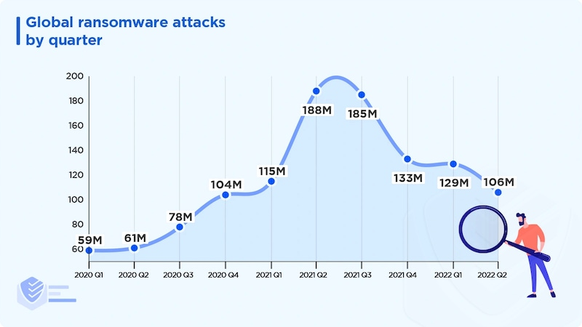
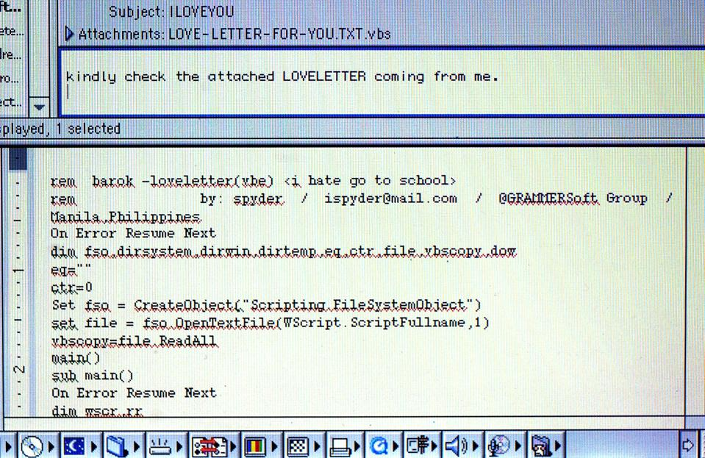
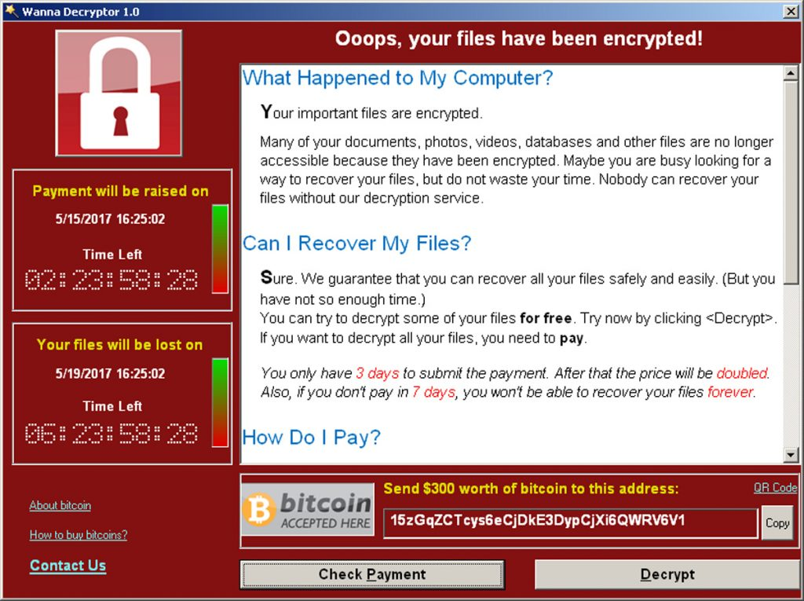
Malware
As software designed to interfere with a computer's normal functioning, malware is a blanket term for viruses, trojans, and other destructive computer programs threat actors use to infect systems and networks in order to gain access to sensitive information.
Provide remote control for an attacker to use an infected machine.
Send spam from the infected machine to unsuspecting targets.
Investigate the infected user’s local network.
Steal sensitive data.

Slide 13
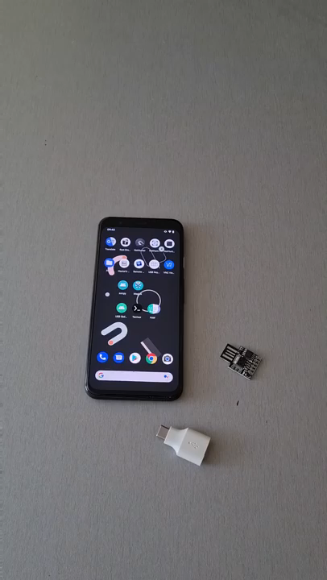
Password Attacks
Password attacks in cybersecurity require special techniques and software. If a hacker is close to you, they may try guessing your password using a combination of names, hobbies, essential years, or numbers.
If that doesn’t work, they use specialized applications that scan through a list of words many people use as passwords. Surprisingly, over 75% of the internet population set passwords consisting of the first 500 words only.
With this in mind, imagine how easy it is for malicious actors to gain access to your crucial information!
That’s why two-factor authentication has become a necessity, adding an extra layer of security.

Slide 14
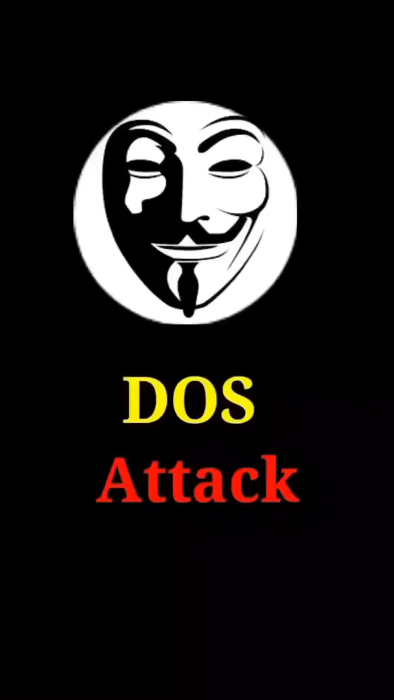
DoS
The primary focus of a DoS attack is to oversaturate the capacity of a targeted machine, resulting in denial-of-service to additional requests. The multiple attack vectors of DoS attacks can be grouped by their similarities.
DoS attacks typically fall in 2 categories:
Buffer overflow attacks
Flood attacks

Slide 15
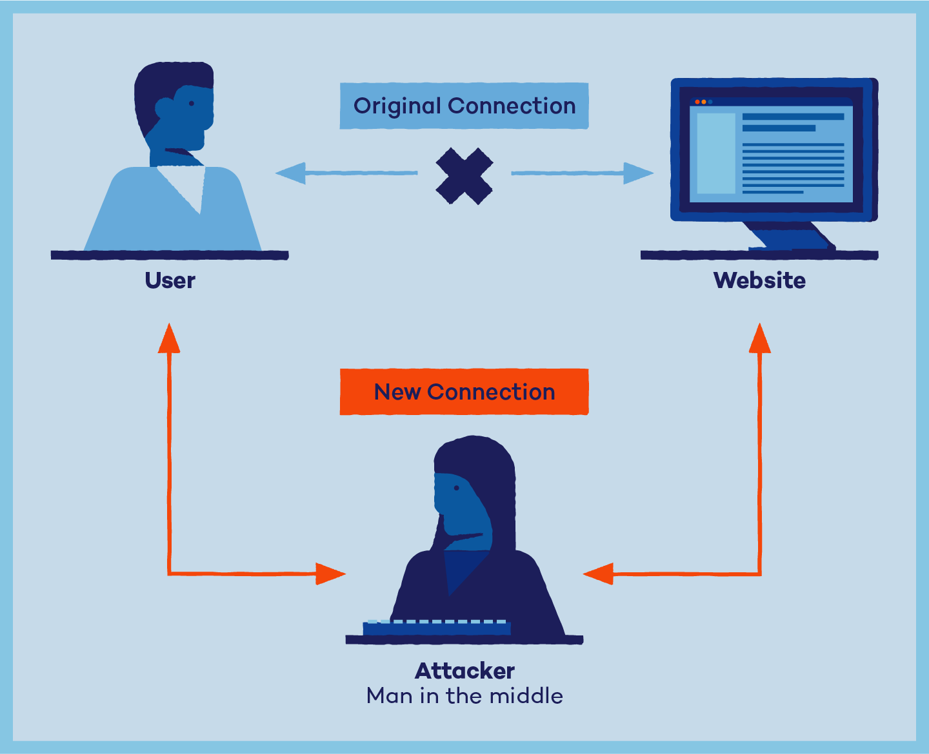
Man in middle
The goal of an attack is to steal personal information, such as login credentials, account details and credit card numbers. Targets are typically the users of financial applications, SaaS businesses, e-commerce sites and other websites where logging in is required.
Information obtained during an attack could be used for many purposes, including identity theft, unapproved fund transfers or an illicit password change.
Additionally, it can be used to gain a foothold inside a secured perimeter during the infiltration stage of an advanced persistent threat (APT) assault.
Broadly speaking, a MITM attack is the equivalent of a mailman opening your bank statement, writing down your account details and then resealing the envelope and delivering it to your door

Slide 16
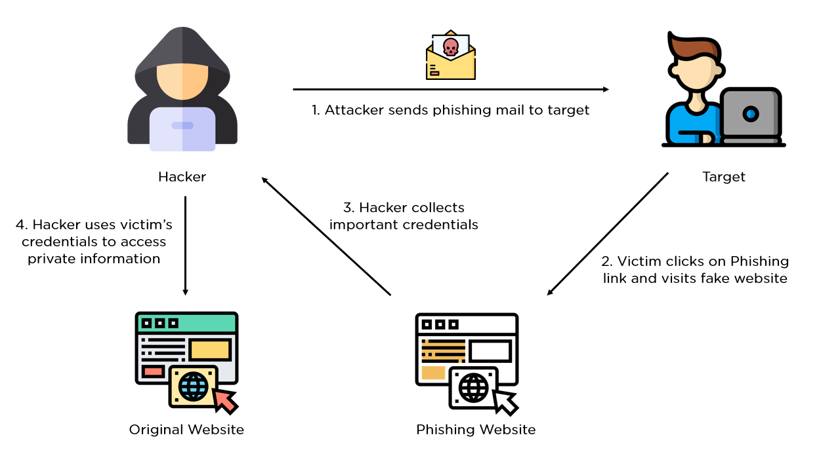
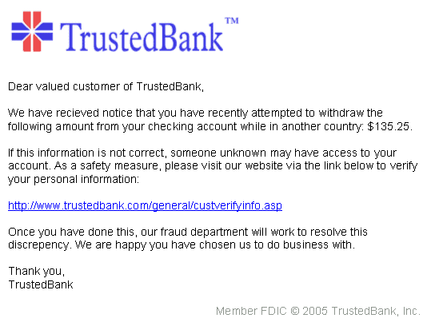
Phishing
Phishing victims are tricked into disclosing information they know should be kept private. Because they trust the source of the information request and believe the party is acting with the best intentions, phishing email victims typically respond without thinking twice.

Slide 17
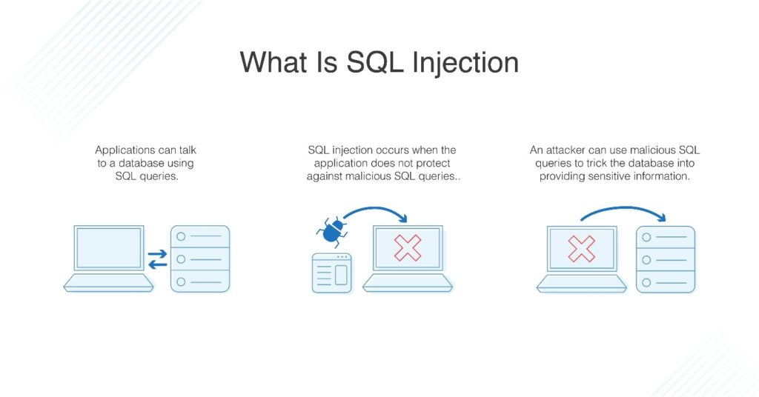
Sql injection
SQL injection (SQLi) is a web security vulnerability that allows an attacker to interfere with the queries that an application makes to its database. It generally allows an attacker to view data that they are not normally able to retrieve. This might include data belonging to other users, or any other data that the application itself is able to access. In many cases, an attacker can modify or delete this data, causing persistent changes to the application's content or behavior.

Slide 18
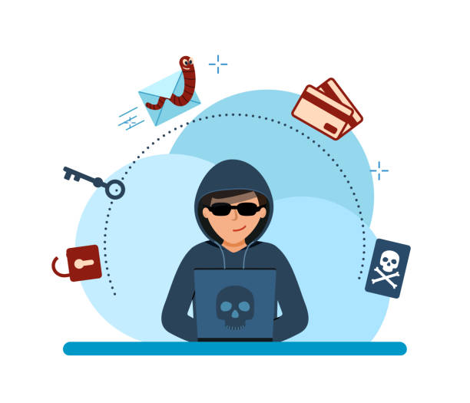
Phases of Hacking
Phase 4
Phase 2
Phase 5
Phase 1
Phase 3
Maintaining Access
Gaining Access
Scanning
Clearing Track
Reconnaissance

Slide 19


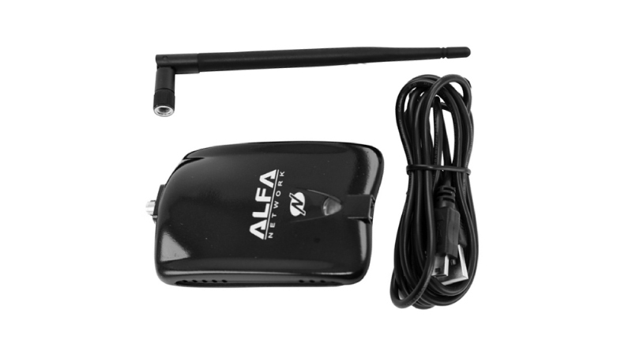
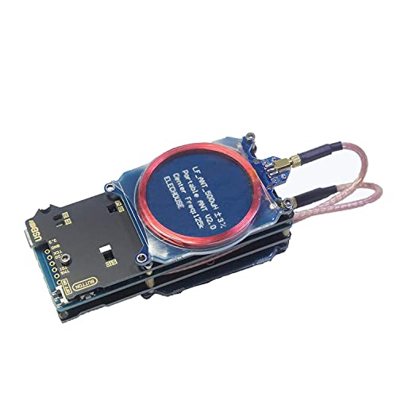
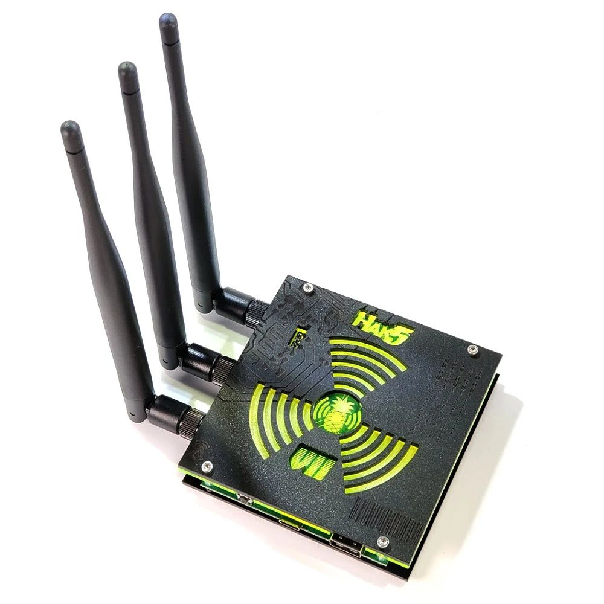
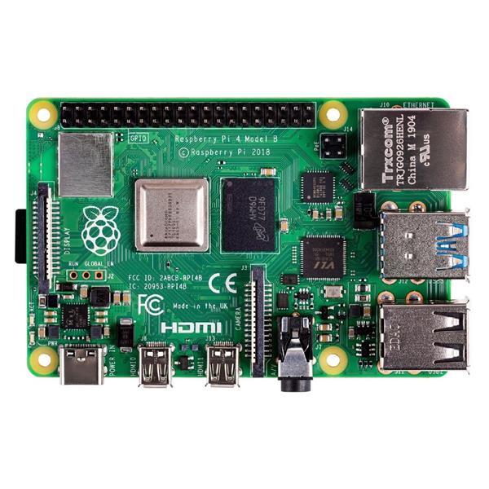
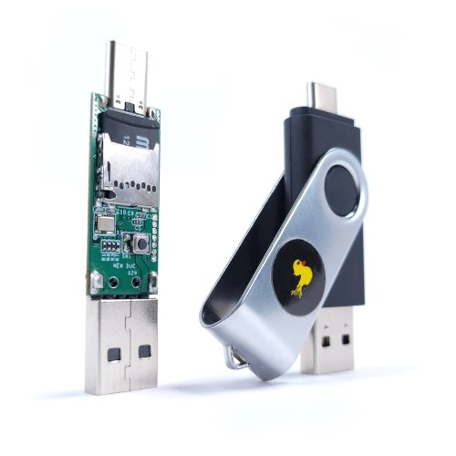
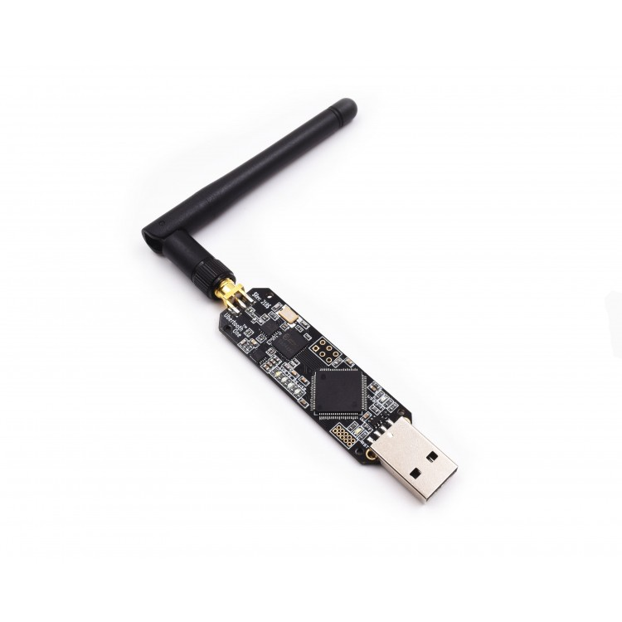
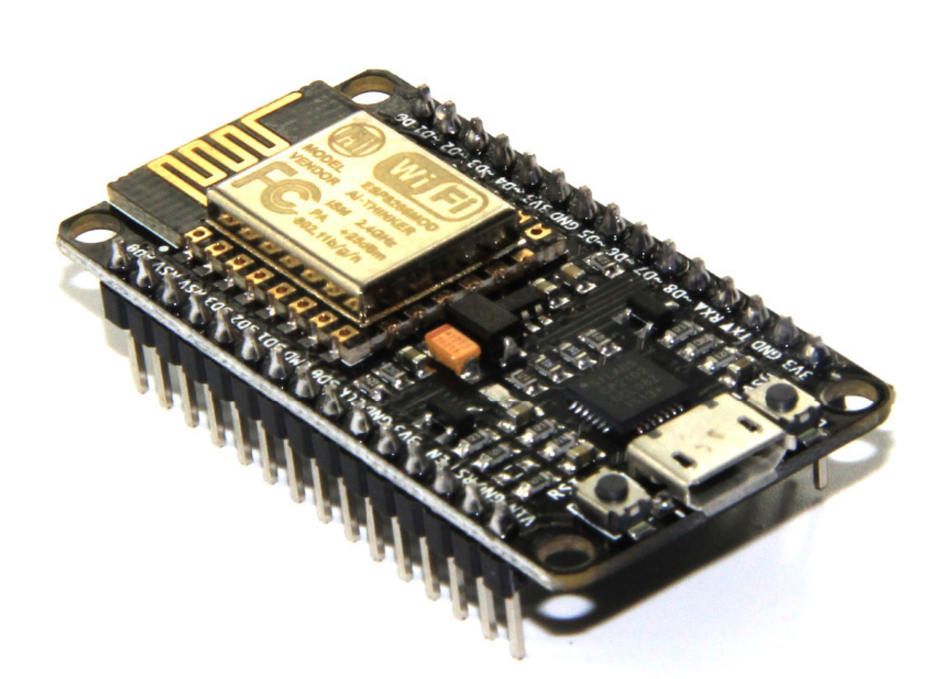
Hacking Hardwares
USB Killer
Hack RF
Wifi monitor adapter
Proxmark
Wifi Pineapple
Ra pi
Rubber Ducky
Uber tooth
Node MCU

Slide 20




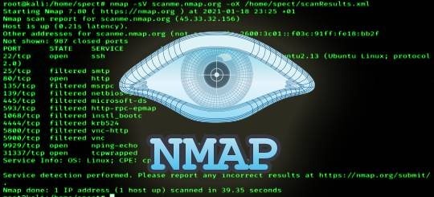



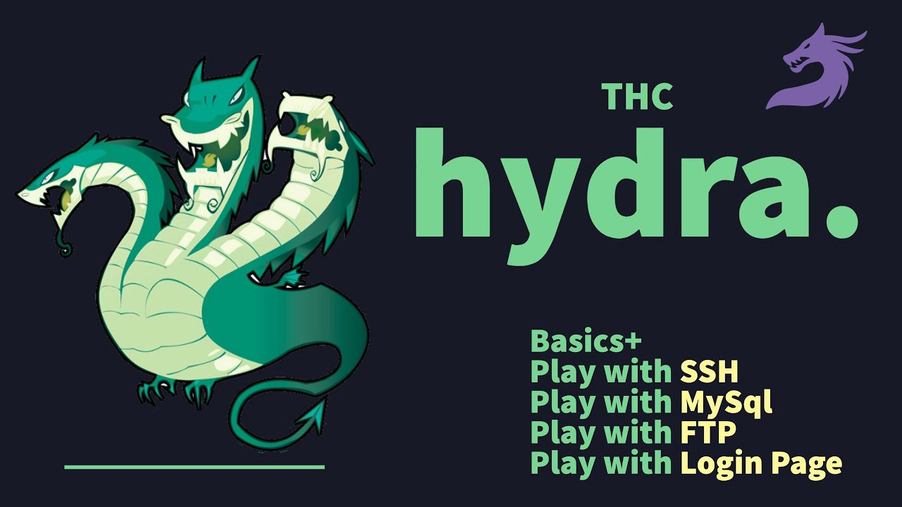
Hacking Tools
Arduino ide
Wire shark
Burp Suite
Metasploit
Nmap
Air Crack NG
Proxy Chain
Kali Linux
Hydra

Slide 21
Preventing cyber threats
Train your self.
Installing spam filters and anti-malware software
Performing vulnerability assessments
Conducting routine penetration testing
Keep your software and systems fully up to date.
Ensure Endpoint Protection.
Install a Firewall.
Backup your data.
Control access to your systems.
networkSecurity.
Storng Password

Slide 22
5.FUTURE WORKS
Automation enabling
Need to be included in education system
Awareness must be given when entering to
Cyber space
Be beware about social engineering

Slide 23
6.CONCLUSION
Cyber security can be described as the collective methods,
technologies, and processes to help protect the confidentiality,
integrity, and availability of computer systems,
networks and data, against cyber-attacks or
unauthorized access.
Cyber Crime is a dangerous offense to
someone's privacy or any material.
Also, we can avoid Cyber Crime by
following some basic logical things and
using our common sense. Above all,
Cyber Crime is a violation of not only
law but of human rights too

Slide 24
REFERENCE
CEH Textbook
EC-Council
Dark web
Google
Stack over flow
Git hub

Slide 25
THANKS!
Do you have any questions?

